Slide 1
Climate Change
Are you able to survive?

Slide 2
Introduction
It’s pleasantly warm outside. The average temperature is pretty nice, bur there are some colder or warmer areas around, so the world to is divided in four habitats.
Five feline species are occupying the arid environment, perfectly adapted to their habitat. Life is easy.
But every now and then the climate changes. When the temperature drops, the ice grows, while when it increases the arid region expands. Species need to adapt quickly or they will get extinct.
Does your species have what it needs to survive?

Slide 3
Contents
5 climate sheets for temperature 1 to 5 (from the coldest to the warmest).
4 species figurines
16 tokens (4 for each habitat)
X mutation cards (10? +1 each gene, 10 - 1 each gene, 30 fun facts)
4 Genomes tables
Patafix
1 dice

Slide 4
Preparation
4 players, each of them is a species. Each player gets:
A species figurine
A yellow token
A genome containing three genes: size, metabolism and colour.
Something to mark the adaptation on the genome board. At the beginning those have to be put on 5, as it is the one associated to yellow.
Two mutation cards.
Put on the table climate board number 3 and place each species in a yellow cell of choice. Cells cannot be shared between players.

Slide 5
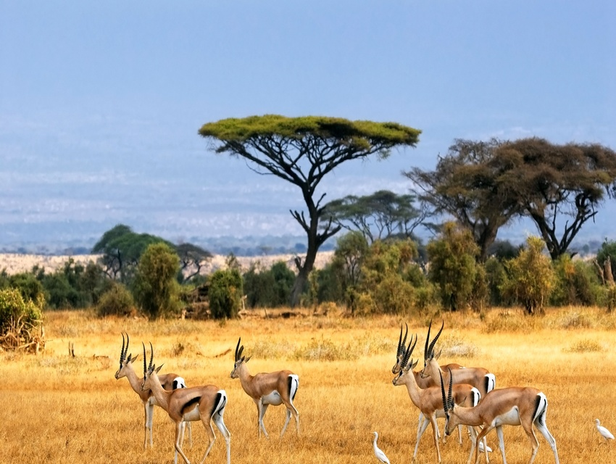
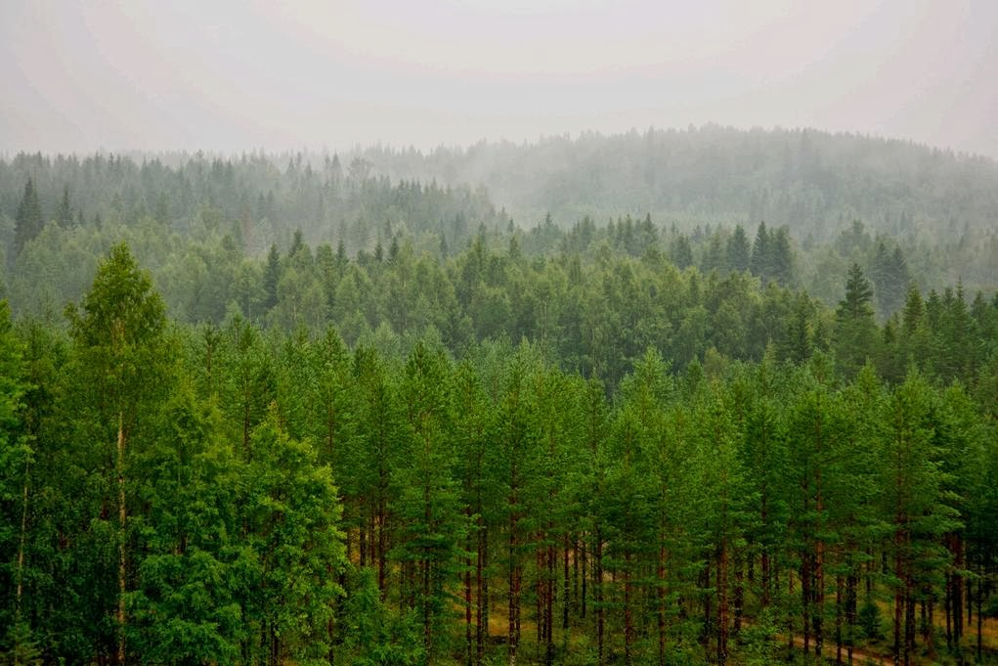
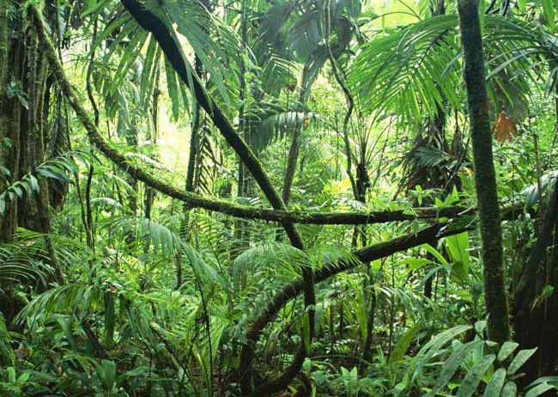
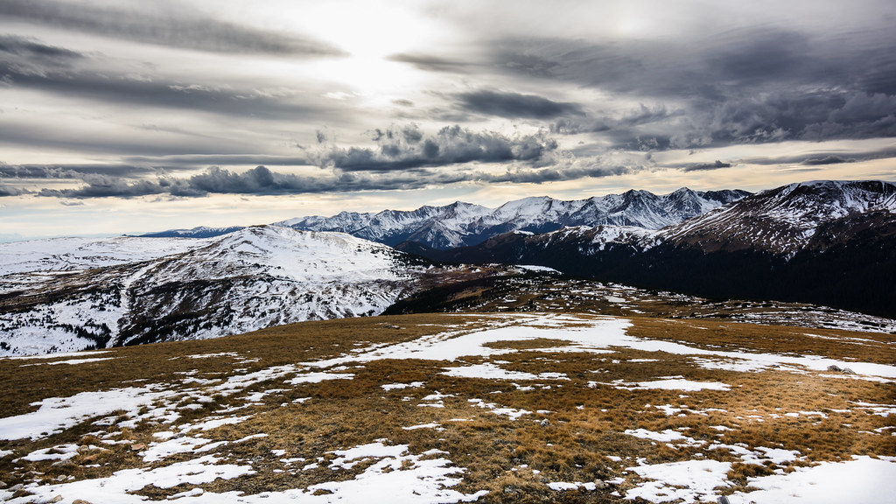
Board: Habitats
TEMP
TUN
TROP
SAV
Savannah: warm and humid, not many trees
Tropical forest: warm and humid, tropical trees
Temperate forest: cold and humid, temperate trees
Tundra: cold and dry, few vegetation, no trees

Slide 6
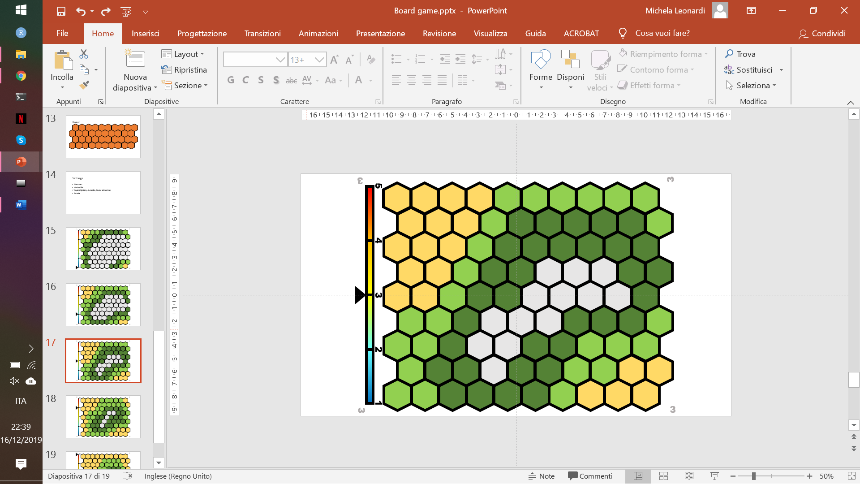
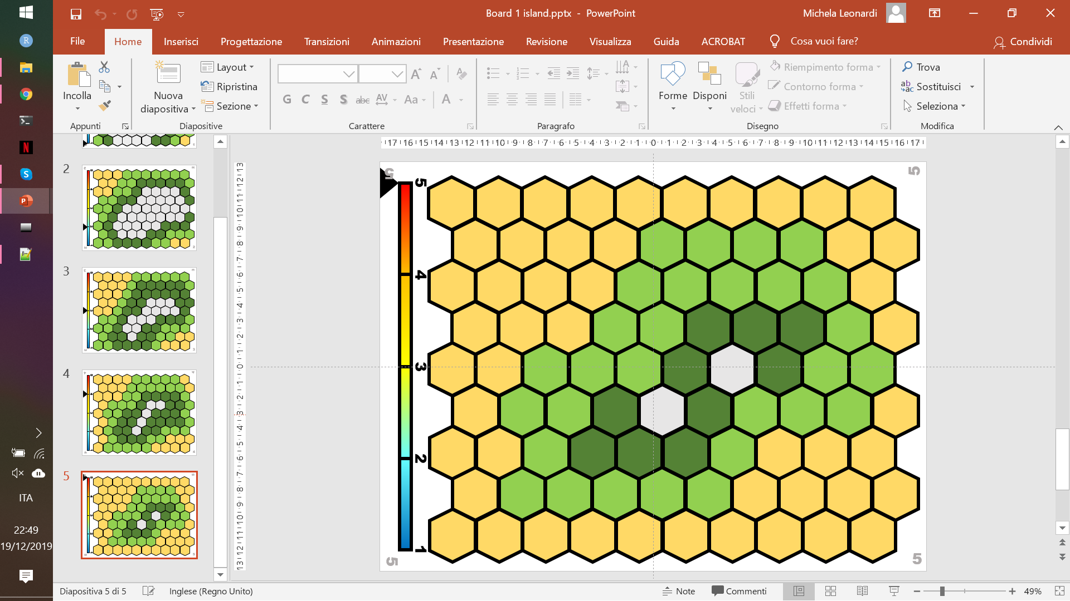
Board: Habitats
There are 5 levels of temperature (bar on the left) each one associated to a specific combination of 4 habitats. Their proportions on the board are based on the overall level of temperature.
Savannah
Tropical forest
Temperate forest
Tundra
TEMP
TUN
TROP
SAV

Slide 7
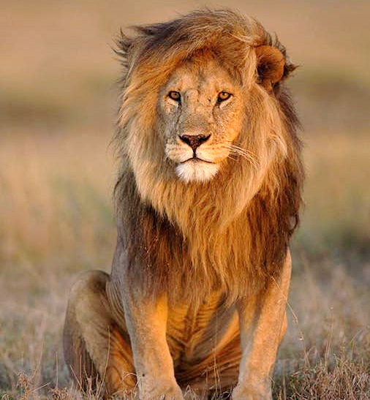
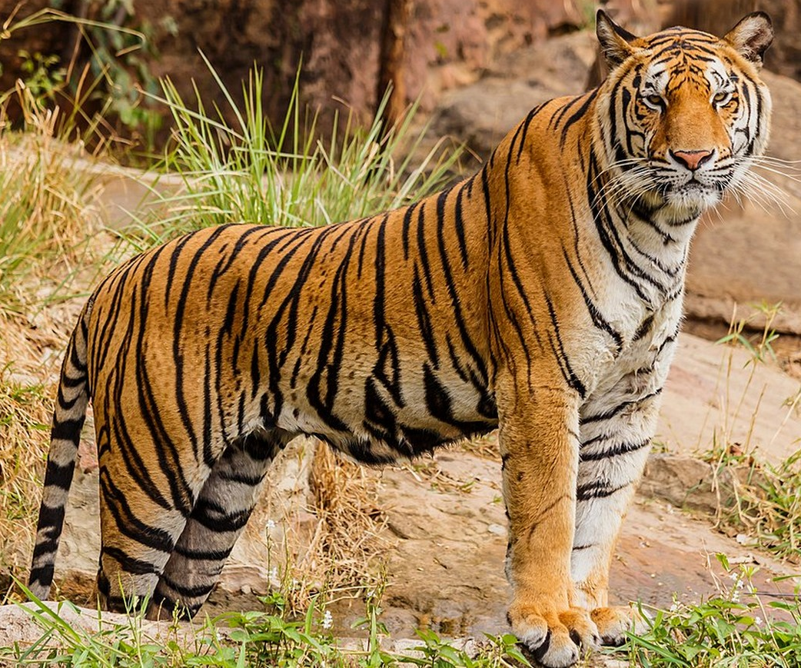
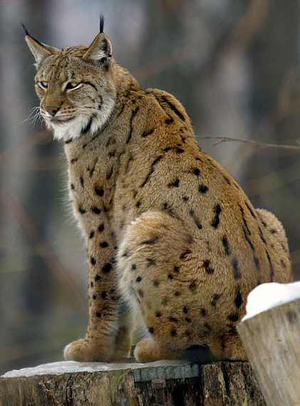
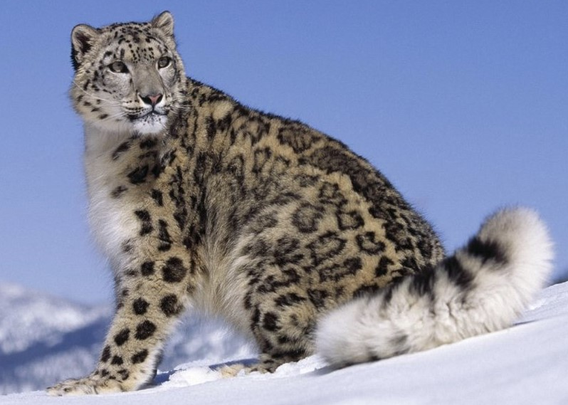
Species
In each habitat lives a species specifically adapted to it.
Savannah: lion
Tropical forest: tiger
Temperate forest: lynx
Tundra: snow leopard
TEMP
TUN
TROP
SAV

Slide 8
How does it work? Adaptation
Can every species live everywhere? No!
The genome (DNA) of each species contains three genes, coding for three characters: fur colour, metabolism, and shape/size of the body. Each gene can be present in four variants (1-4) each of them associated to an habitat.
In order to survive in any given environment the species must possess at least two of the gene variants associated to the habitat itself. It is possible to adapt to new habitats by having new mutations, i.e. using mutation cards to change the values of the gene variants.

Slide 9
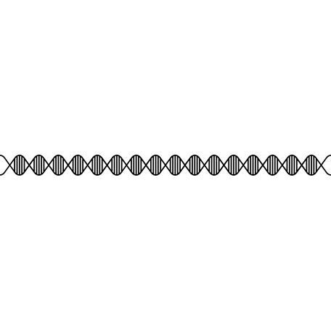
Genome board description
CATGAATATTGTACGGTACCATAAATACTTGACCACCTGTAGTACATAAAAACCCAATCCACATC
3 Genes:
Four variants (=values) for each of them, each allowing adaptation to a specific habitat: from 1 (adapted to ice) to 4 (adapted to arid).
A little SOMETHING marks the current level of adaptation.
The value can be changed using the mutation cards (+/-1) associated to each gene. Some cards are neutral, i.e. do not change the value of any gene.
GENOME BOARD
 | COLOR | BODY | METABOLISM
4 | Yellowish | Big and skinny | Fast
3 | Orange striped | Big and robust | Quite fast
2 | Brownish spotted | Small and robust | Quite slow
1 | Grayish spotted | Medium and chubby | Slow
TEMP
TUN
TROP
SAV

Slide 10
-1
-1
-1
ACTTGACCACCTGTAG
ACTTGACCACCTGTAG
ACTTGACCACCTGTAG
ACTTGACCACCTGTAG
ADAPTATION CARD
BODY
ADAPTATION CARD
COLOR
ADAPTATION CARD
METABOLISM
Fun fact about felines, climate change etc.
+1
+1
+1
ACTTGACCACCTGTAG
ACTTGACCACCTGTAG
ACTTGACCACCTGTAG
NEUTRAL CARD
FUN FACT
ADAPTATION CARD
BODY
ADAPTATION CARD
COLOR
ADAPTATION CARD
METABOLISM

Slide 11
How to play
The game starts from board 3, with each player in a cell of choice within the Savannah. It is not possible for two or more species to share a cell.
At each turn the player picks a mutation card (to be kept covered) and rolls the dice. If the player has more than 8 cards one at random must be discarded (put at the bottom of the discarded pile)
If the value of the dice is between 1 and 3 the species stays where it is, and the turn goes to the next player.
If the value of the dice is between 4 and 6 the species has to move to a neighbouring unoccupied cell of choice.
When the species want to move to a different habitat it needs to adapt, i.e. have the value associated to the new habitat in at least two genes. Such values are changed using mutation cards (specific for each gene) giving +1 or -1 as needed.
Each time a card is used it is put back in the discarded pile. Each time a new habitat is occupied, a token is given to the player. When there are no more cards available the discarded pile is shuffled and put back as pile.

Slide 12
Climate change
At the end of each round the dice must be thrown. If it makes 1 or 6 the climate changes. A second roll of the dice tells if the climate goes one step down (1-3) or up (4-6).
If the climate is already 1 or 5 it can only go respectively up and down. Then the board is changed to the relevant new one.
After the climate change, each player that rolls a 1-3 either is adapted to the cell it is in, or should adapt to it with the DNA cards. If it is not possible to adapt the species get extinct (see next slide).
If the player rolls 4-6 he/she can move two steps instead of one, and needs to be adapted or to adapt to the new location to not get extinct.

Slide 13
Extinction
If the species find itself in an habitat to which it is not possible to adapt (e.g.no cards available to allow correct adaptation) it get extinct.
When a species get extinct it gives back all cards and tokens but the yellow one. It then moves to a yellow cell of choice and gets two new cards.

Slide 14
Aim of the g ame
forest
arid
steppe
ice
Wins the game the player that collect all 4 habitat tokens

Slide 15
1
1
5
4
3
2
1
1
1

Slide 16
2
2
5
4
3
2
1
2
2

Slide 17
3
3
5
4
3
2
1
3
3

Slide 18
4
4
5
4
3
2
1
4
4

Slide 19
5
5
5
4
3
2
1
5
5

